Slide 1
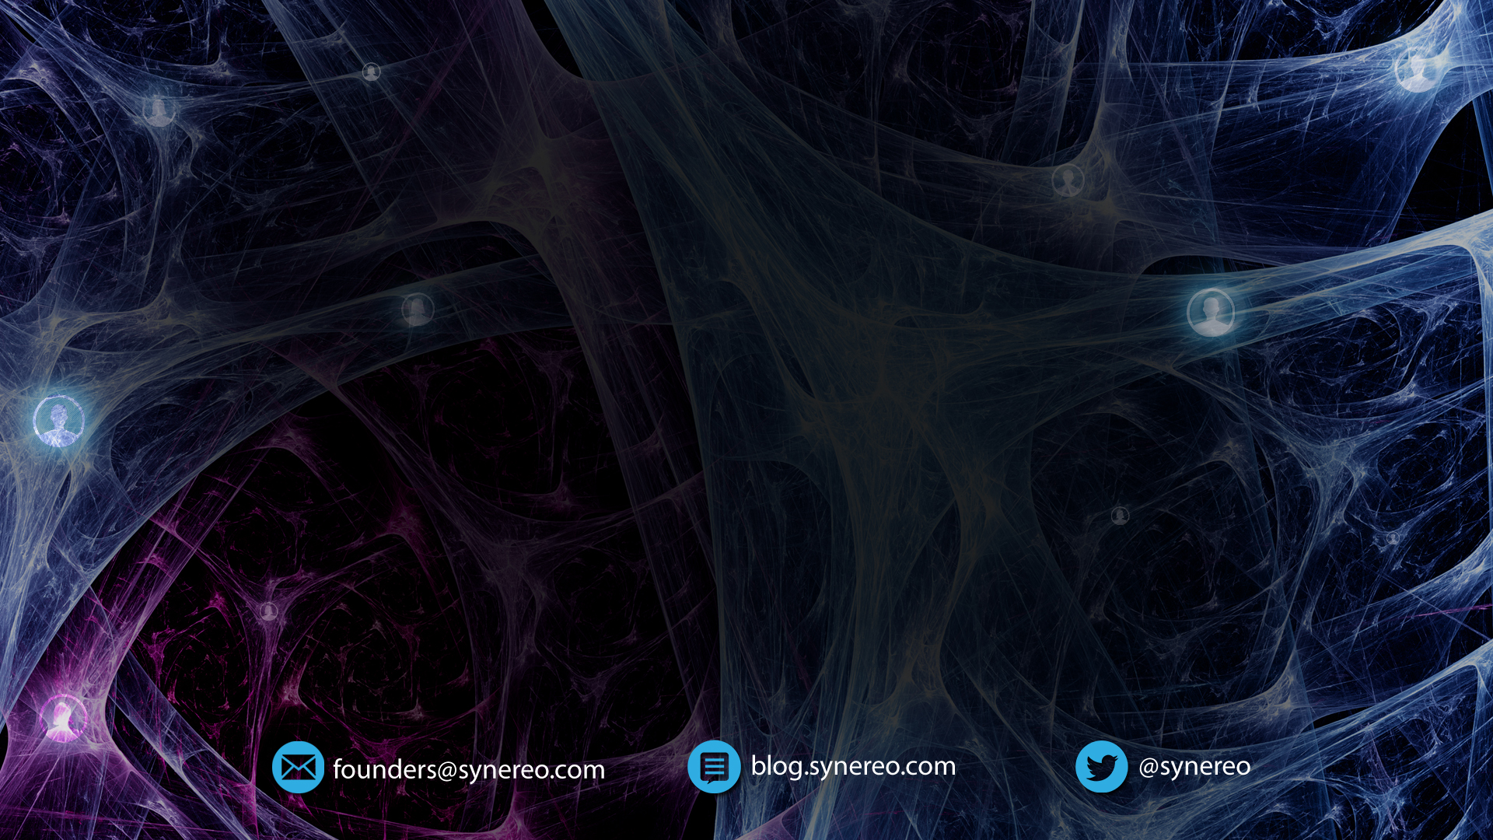
Distribution Tech and Human Progress
The Case for a Distributed Social Network
Dor Konforty, Jan 2015

Slide 2

Alternative Titles
Civilization: add technology and bake for five millennia
Replacing trust with technology
How to put everyone in the same boat. Also why
Notes:
Who read the ANN?

Slide 3
Making Predictions About Reality
Western science provides us with predictions about how things change with time.
Physical Forces
Entropy
Biological Evolution
Can we predict how societies change?
Notes:
This starts heavy. Need a lighter start/joke.

Slide 4
Taking The Long View
In this presentation, we’ll talk about a framework that makes thinking about human history easier.
Specific stories – gods, ideologies, cultures – are irrelevant.

Slide 5
Our Talk Will Follow
The homo-sapiens animal as it evolves from hunter-gatherer societies to modern civilization (and beyond).

Slide 6
Humans Are Dangerous
As a human, other people are one of the biggest dangers you may face.
They are the most fierce competitors for resources.

Slide 7
Humans Are Beneficial
They’re also the biggest boon to your ability to survive and to your quality of life.
Evolution has proven cooperation to be useful to the survival of the individual – embedding its logic in our genes.
Notes:
Empathy, being born with cooperative behaviors, sense of justice, etc

Slide 8
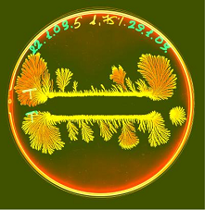
Why can’t we all just… get along?
What made people and groups form tribes or split off of them in the petri dish of our ancestral habitats?
Notes:
-- even though resources abounded!

Slide 9
It’s In Our Genes
Humans are wired to be suspicious of those they do not know.
However, once they start communicating, tensions ease off.

Slide 10
How To Ease Tensions
Mere exposure effect
Communicating with the same language
Working towards the same goal
Iterations of interactions
Coming up with new ways to cooperate and receive mutual benefit

Slide 11
Limits
Time and energy for communications are limited, and so there is a finite size for a group that can function cohesively. When it is crossed, tensions increase, and a group may split off.
These groups will often continue having tensions between them, living in a perpetual state of war.

Slide 12
We’ll Need Bigger Boats
How do we increase that size and create larger spheres of cooperation?

Slide 13
Non-Zero-Sumness
New technologies arise that permit or encourage new, richer form of non-zero-sum interaction; then - for reasons grounded in human nature - social structures evolve that realize this rich potential, that convert non-zero-sum situations into positive sums.
Thus does social complexity grow in scope and depth.

Slide 14
Nonzero
Tomas Schelling: no rational reason to communicate in a purely zero-sum relationship.
Societies are non-zero-sum arrangements!
Notes:
Sports game coach example

Slide 15
Prisoner’s Dilemma
Barriers to cooperation/non-zero-sumness:
Communication
Trust (fear of being cheated)
Iteration (reputation)
What else could affect the outcome of the prisoner’s dilemma?

Slide 16
Meta-Order
The order of order.
Also: superstructure (Marx), imagined order (Harari).

Slide 17
Nonzero
Four main ingredients for non-zero-sumness:
Communication
Trust
Reputation
Meta-Order

Slide 18
Technology
Communications
Trust (Trustlessness?)
Degrees of
Freedom
Non-Zero
Sumness
Reputation
Meta-Order

Slide 19
Technologies
We skip technologies like biological inter-cellular communications and early spoken language to focus on the homo-sapiens we know today and jump straight to the invention of the NET.

Slide 20
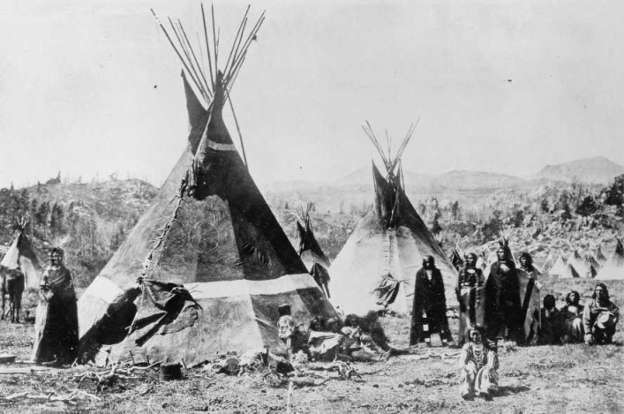
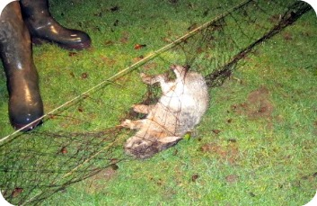
Technology: The Net
The first net connecting people was invented by the Shoshoni, a North Native American tribe.
Notes:
* Not really the first

Slide 21
First Signs of The Social Brain
The Shoshoni also invented the Party.
A social networking / social information processing system.
Who led the effort? Who contributed more? Who should get more resources? Who should I collaborate with next?
A social order is born!
We can start talking meaningfully about the social brain: making informed social and economic decisions for the tribe.

Slide 22
Technology:
Rabbit Net
Communications
Trust
Degrees of
Freedom
Non-Zero
Sumness
Reputation
Meta-Order: Big Man
Tribe

Slide 23
Technology: Agriculture
The Agricultural revolution sweeps the old world 11,000 years ago: More people can now live in the same place. Communications ++.
Many people living close together leads to tension.
Agriculture allows less people to work for food, leading to specialization -> more non-zero-sum opportunities.
Still, a Chief is needed to lay down the law and use force to maintain order.

Slide 24
Technology:
Agriculture
Communications
Trust
Degrees of
Freedom
Non-Zero
Sumness
Reputation
Meta-Order:
Chief, Religion
Village
Notes:
-- also collection of villages

Slide 25
The First Centralized Power
Chiefs have access to all of the goods created and incredible power. He is religion manifest.
When does the Chief help create more complex social order and when does he become a parasite?
How do we distribute his power?
Notes:
-- Up until now, religions were animistic and mostly didn’t interfere with how life *should* be lived. From this point on, religions start being used as a tool for creating order.

Slide 26
Technology: Writing
Writing: the first distributed information tech (in this talk).
Sumerians in the Tigris-Euphrates (הפרת והחידקל)
Clay cones and spheres pressed against envelope.
Distributed trust.
Meta-order: Laws.
Cuneiform (כתב יתדות), 1 and 10.
More abstract notions emerged (symbol for wheat, livestock, etc) with numbers near them -> economical language, economy boost.
Notes:
3D clay symbols -> envelopes -> 2D tablets

Slide 27
Technology:
Writing
Communications
Trust
Degrees of
Freedom
Non-Zero
Sumness
Reputation
Meta-Order:
Laws
Civilization
Notes:
-- Less whimful Chief, more established laws that people can rely on and trust
-- Reducing the meta-order down to a level closer to the agents the order applies to

Slide 28
Replacing Trust With Tech
People can create their own contracts. No need for public displays of debt accretion or a central authority to approve/enforce every interaction.
When we replace trust with distribution tech, we can rely less on meta-order.
The meta-order fights for its existence!
Conatus: an innate inclination of a thing to continue to exist and enhance itself. Its “will to live”.
Notes:
-- How much energy is saved by not having to rely on crowds in feasts to be debt-keeping mechanisms!

Slide 29
So How Do Things Change?
A nation must accept new technologies and reap their non-zero-sum fruits if it is to stay competitive and survive. It can no more afford to ignore information tech than it can ignore the bronze shield or the musket.
Notes:
-- How much energy is saved by not having to rely on crowds in feasts to be debt-keeping mechanisms!

Slide 30
Technology: Press, Radio
Distribution of knowledge. Distribution of information creation and sharing.
Notes:
We’ll quickly jump through some more technologies …

Slide 31
Technology:
Information Tech
Communications
Trust
Degrees of
Freedom
Non-Zero
Sumness
Reputation
Meta-Order:
Ideologies
Globalization

Slide 32
Centralization
Most information still goes through central broadcasting.
Central authority means friction.
Skimming off the top.
Taking as much as you can before people revolt (because if you don’t, someone who can – will).
Notes:
Don’t hate the player, hate the game.
(Don’t hate the game. Create a better one.)

Slide 33
Constructal Law
Constructal Law (Flow), degrees of freedom
“If we know what is moving through a flow system, we can predict the sequence of designs that will emerge and evolve to facilitate the currents that run through it”.
- Adrian Bejan, Design in Nature: How the Constructal Law Governs Evolution in Biology, Physics, Technology, and Social Organization
Notes:
-- The elimination of friction from the system

Slide 34
Intelligence and Flow
Human (social?) intelligence
“Should be viewed as a physical process that tries to maximize future freedom of action and to avoid constraints in its own future.“
Dr. Alexander D. Wissner-Gross
Notes:
How do we improve intelligence?

Slide 35
The Internet Age
Computers, Internet.
Further distribution of knowledge and ability to create messages
Still rely on centralized entities.
Bruce Sterling calls them “the Stacks”: the gargantuan American companies that control so much of what the world does on the Internet. The greater Stacks: Amazon, Apple, Facebook, Google, Microsoft. The lesser Stacks: Netflix, Twitter, Yahoo!.
Between them, they probably know, conduct, control, manipulate, and monetize almost all of the following: your phone, your computer, your email, your online shopping, your social media, your videos, your games, your news — in other words, your entire online (and, increasingly, offline) existence.

Slide 36
Technology:
Internet
Communications
Degrees of
Freedom
Trust
Non-Zero
Sumness
Reputation
Meta-Order:
Facebook, Google, NSA
Internetsville

Slide 37
Enter Blockchain
Mitbakesh!
Decentralization and distribution, more degrees of freedom.
Cryptocurrencies are a boon for distributed, non-zero-sum economic interactions!
Notes:
(Mitbakesh: warranted to happen/self-evident/expected)

Slide 38
Technology:
Blockchain
Communications
Degrees of
Freedom
Trust
Non-Zero
Sumness
Reputation
Meta-Order:
Algorithms
Internetsville

Slide 39
An Environment For Innovation
“If you look at history, innovation doesn't come just from giving people incentives; it comes from creating environments where their ideas can connect.”
- Steven Johnson
And I would add:
Where ideas can’t be inhibited or manipulated for someone else’s gain.

Slide 40
The Synereo Social Network
Distribution, no middlemen, no friction -> more freedom.
Freedom from central control / profit axiom means more options for interaction and more value generated in the web of exchange.
Attention economy: reputation, efficient information flow, higher individual and community agency. Intelligence++?
No(?) restrictions.
Almost full reliance on local rules.
Notes:
(more on Attention Economy later)

Slide 41
Technology:
Synereo
Communications
Degrees of
Freedom
Trust
Non-Zero
Sumness
Reputation
Meta-Order:
Community
Internetsville

Slide 42
Synereo Principles
Full distribution? Near-instant communications? Reliance on local rules? Reputation shaping information flow? Attention economy?
What does this remind us of?

Slide 43
Braiiinnnnsss
In the brain, each Neuron – an agent in the system – has many functions:
Relay station
Short term memory
Long term memory
Processing unit
Meta-order is created through complex collaboration, all based on decisions taken at the level of the Neuron and local rules. No other entity is required.

Slide 44
Meta-Order?
Hierarchies still exist, but must act locally.
Otherwise, the overhead of maintaining global states is too large and creates huge communication issues.
A peer to peer architecture solves this.

Slide 45
Advantages of P2P
Robustness, flexibility and emergent complexity.
Engineering capabilities and things we did not think of originally will be ways in which a conventional system is made brittle to its assumptions.
All capabilities must have been anticipated – or otherwise patched in, and so we end up with the kind of hodge podge mess that is endemic in much of modern computing.

Slide 46
Self Organization
Requires a set of fundamental, local rules that form the basis for interaction.
Emergent complexity is the composition of these base properties.
The network is more adaptable and so more robust. Changing things is not a huge top down engineering process that is fragile, but altering or adding to the base rules.
People are able to compose and connect things in ways no one could have imagined in the first place. The system becomes much more extensible and modular.

Slide 47
Trustlessness
Trustlessness becomes so ingrained in the system that global meta-order becomes almost redundant!
Social smart contracts.
The community decides what goes.
Fully extensible and free, there is room for play. For evolution. For more non-zero-sum interactions.

Slide 48
Play
"We believe that the major success of the Internet and then world wide web was its distributed DIY approach to building and maintaining a communications infrastructure.“
– Gregory Meredith, Synereo Chief Science Officer
Notes:
Where did this go.. ?

Slide 49
Attention Economy
Attention economy – the evolution of reputation. Reputation built into the platform.
Who contributed to the network and in what context? Where should information go and who should attend to it next? Whose attention should I acquire for this task?
Better flow of information -> crucial for intelligence. Further increases degrees of freedom.

Slide 50
Synereo Technology
(Yuval Tech Slides)
Notes:
Local rules and consensus, no need for global ledger, offlineity, public-key cryptography, smart contracts, collaborative platform social smart contract logo creation use-case

Slide 51
Bonus
Social physics
http://socialphysics.media.mit.edu/

Slide 52
Summary
We know how social evolution works without having talked about any specific god or religion even once.

Slide 53
Summary
Human history involves the playing of more and more non-zero-sum games, accumulated on top of one another, ever growing more interconnected and elaborate.

Slide 54
Summary
We pinpointed a few “global rules” that are identified at every stage and at every level:
Non-Zero-Sumness
Conatus
Constructal Law

Slide 55
Summary
We know what the barriers to non-zero-sumness are:
Lack of communication
Lack of trust (fear of being cheated)
Lack of reputation
Inhibitive meta-order

Slide 56
The End
"When wireless is perfectly applied, the whole earth will be converted into a huge brain, which in fact﻿ it is, all things being particles of a real and rhythmic whole."
Nikola Tesla, 1929

Slide 57
Technology:
Enlightenment
Communications
Degrees of
Freedom
Trust
Non-Zero
Sumness
Reputation:
Unnecessary
Meta-Order:
Enlightened Self-Interest
Meta-State
Transition

Slide 58
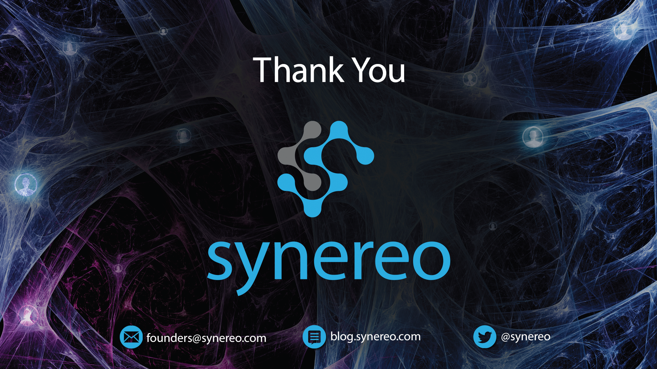
Dor Konforty, Jan 2015

